Slide 1
Morphological Operations

Slide 2
Morphological Operations
Morphological operations apply a structuring element to an input image, creating an output image of the same size.
The most basic morphological operations are dilation and erosion.
You can perform common image processing tasks, such as contrast enhancement, noise removal, thinning, skeletonization, filling, and segmentation.

Slide 3
Dilation and Erosion
Dilation adds pixels to the boundaries of objects in an image, while erosion removes pixels on object boundaries.
The number of pixels added or removed from the objects in an image depends on the size and shape of the structuring element used to process the image.

Slide 4
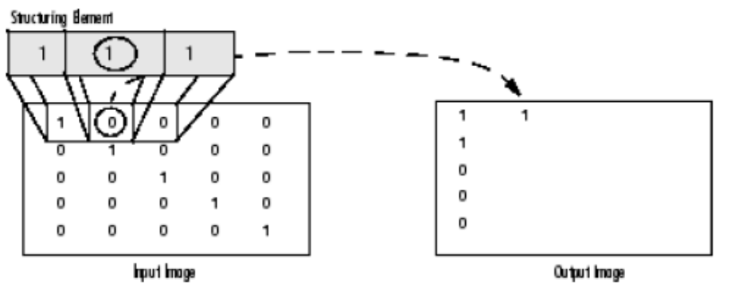
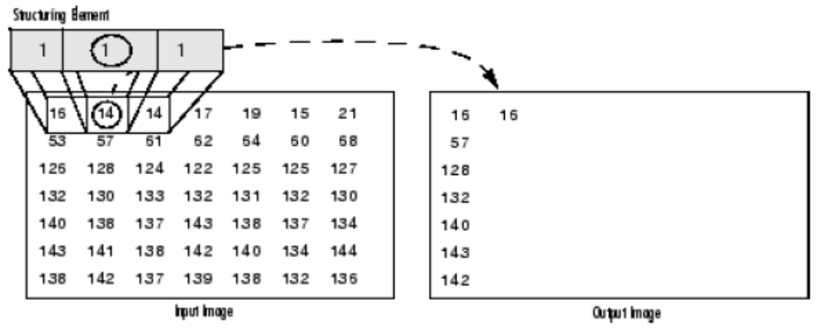
Dilation
The value of the output pixel is the maximum value of all the pixels in the input pixel’s neighborhood. In a binary image, if any of the pixels is set to the value 1, the output pixel is set to 1.

Slide 5
Erosion
The value of the output pixel is the minimum value of all the pixels in the input pixel’s neighborhood. In a binary image, if any of the pixels is set to 0, the output pixel is set to 0.

Slide 6
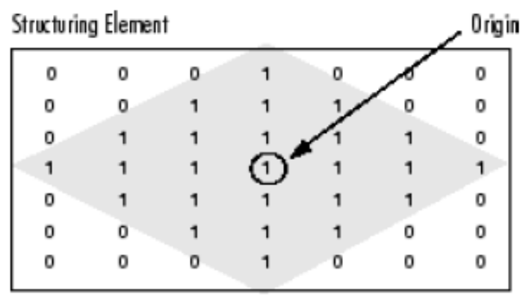
Structuring Elements
An essential part of the dilation and erosion operations is the structuring element used to probe the input image.
A structuring element is a matrix consisting of only 0’s and 1’s that can have any arbitrary shape and size.
The pixels with values of 1 define the neighborhood.

Slide 7
Creating a Structuring Element
You use the strel function to create STRELs of any arbitrary size and shape.
The strel function also includes built-in support for many common shapes, such as lines, diamonds, disks, periodic lines, and balls.
For example, this code creates a flat, diamond-shaped structuring element.
se = strel('diamond',3)
0 0 0 1 0 0 0
0 0 1 1 1 0 0
0 1 1 1 1 1 0
1 1 1 1 1 1 1
0 1 1 1 1 1 0
0 0 1 1 1 0 0
0 0 0 1 0 0 0

Slide 8
Structuring Element Decomposition
To enhance performance, the strel function might break structuring elements into smaller pieces.
For example, dilation by an 11-by-11 square structuring element can be accomplished by dilating first with a 1-by-11 structuring element, and then with an 11-by-1 structuring element.
  This results in a theoretical speed improvement of a factor of 5.5, although in practice the actual speed improvement is somewhat less.

Slide 9
Dilating an Image
To dilate an image, use the imdilate function. The imdilate function accepts two primary arguments:
  The input image to be processed (grayscale, binary, or packed binary image)
  A structuring element object, returned by the strel function, or a binary matrix defining the neighborhood of a structuring element

Slide 10
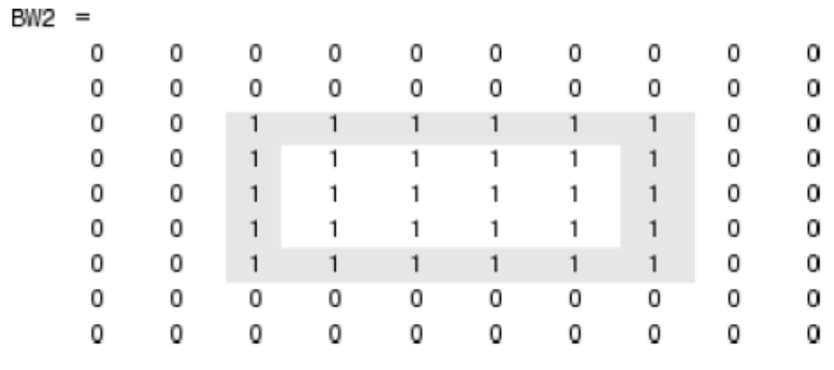
BW = zeros(9,10);
BW(4:6,4:7) = 1
BW =
0 0 0 0 0 0 0 0 0 0
0 0 0 0 0 0 0 0 0 0
0 0 0 0 0 0 0 0 0 0
0 0 0 1 1 1 1 0 0 0
0 0 0 1 1 1 1 0 0 0
0 0 0 1 1 1 1 0 0 0
0 0 0 0 0 0 0 0 0 0
0 0 0 0 0 0 0 0 0 0
0 0 0 0 0 0 0 0 0 0
SE = strel('square',3)
Neighborhood:
1 1 1
1 1 1
1 1 1
BW2 = imdilate(BW,SE)

Slide 11
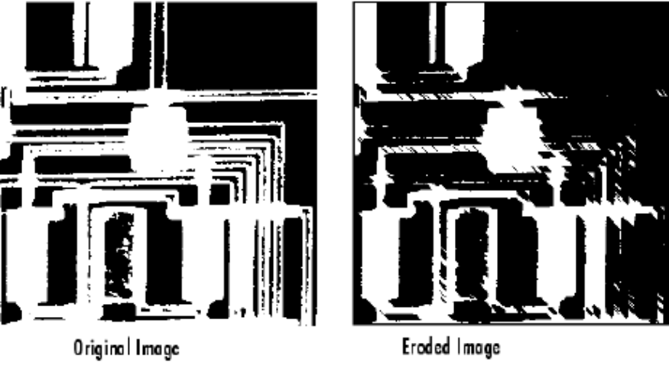
Eroding an Image
BW1 = imread('circbw.tif');
Create a structuring element. The following code creates a diagonal structuring element object.
SE = strel('arbitrary',eye(5));
Neighborhood:
1 0 0 0 0
0 1 0 0 0
0 0 1 0 0
0 0 0 1 0
0 0 0 0 1
BW2 = imerode(BW1,SE);
imshow(BW1)
figure, imshow(BW2)

Slide 12
Morphological Opening
You can use morphological opening to remove small objects from an image while preserving the shape and size of larger objects in the image.
The definition of a morphological opening of an image is an erosion followed by a dilation, using the same structuring element for both operations.

Slide 13
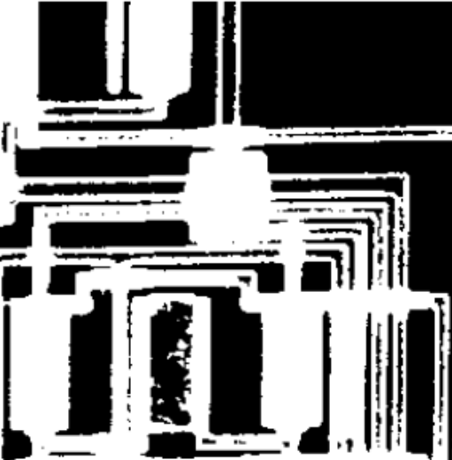


BW1 = imread('circbw.tif');
SE = strel('rectangle',[40 30]);
The structuring element should be large enough to remove the lines when you erode the image, but not large enough to remove the rectangles.
  It should consist of all 1’s, so it removes everything but large contiguous patches of foreground pixels.
BW2 = imerode(BW1,SE); imshow(BW2)
This removes all the lines, but also shrinks the rectangles.
To restore the rectangles to their original sizes, dilate the eroded image using the same structuring element, SE.
BW3 = imdilate(BW2,SE); imshow(BW3)

Slide 14
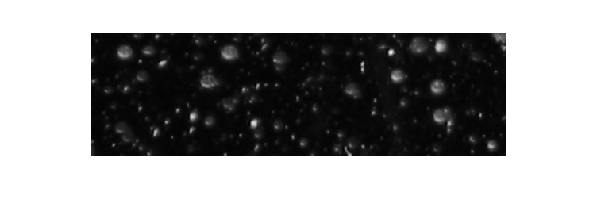
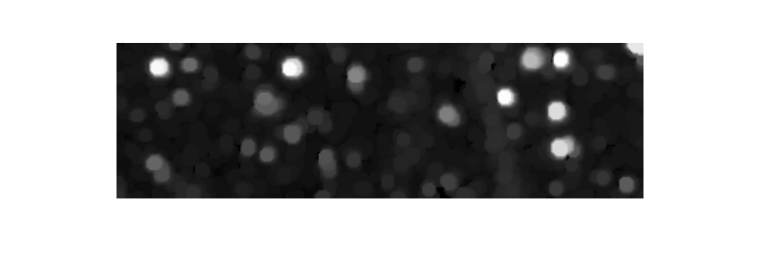
Remove snowflakes having a radius less than 5 pixels by opening it with a disk-shaped structuring element having a 5 pixel radius.
original = imread('snowflakes.png');
se = strel('disk',5);
afterOpening = imopen(original,se);
figure, imshow(original), figure, imshow(afterOpening,[])

Slide 15
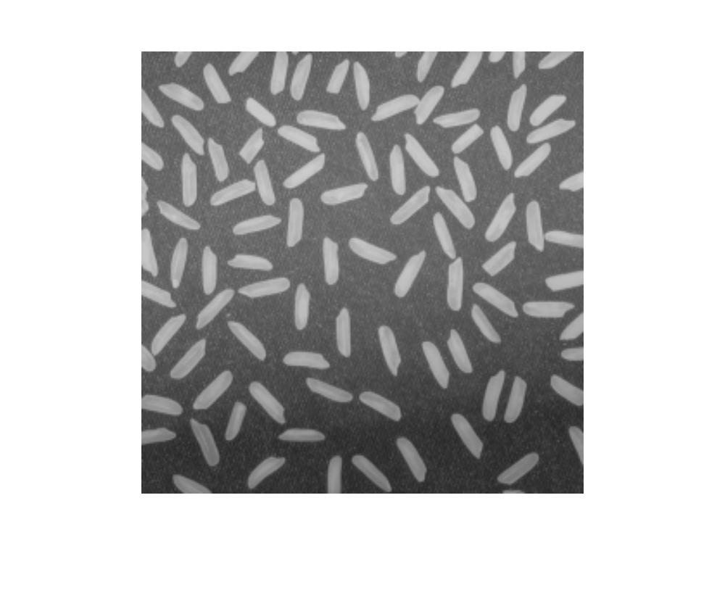
Correcting Nonuniform Illumination and compute statistics for all the grains in the image
I = imread('rice.png');
imshow(I)

Slide 16
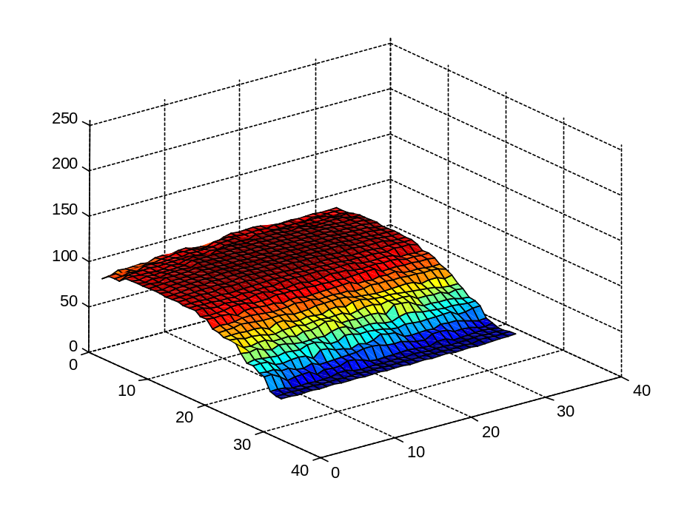
Use Morphological Opening to Estimate the Background
Notice that the background illumination is brighter in the center of the image than at the bottom. Use the IMOPEN function to estimate the background illumination.
background = imopen(I,strel('disk',15));
% Display the Background Approximation as a Surface
figure, surf(double(background(1:8:end,1:8:end))),zlim([0 255]);
set(gca,'ydir','reverse');

Slide 17
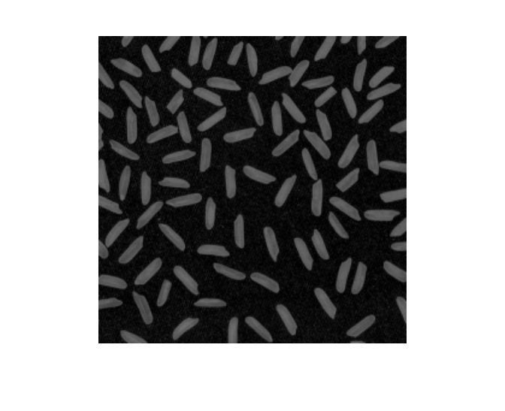
Subtract the Backround Image from the Original Image
Since the image and background are of class uint8, use the function IMSUBTRACT to subtract the background.
I2 = imsubtract(I,background);
imshow(I2)

Slide 18
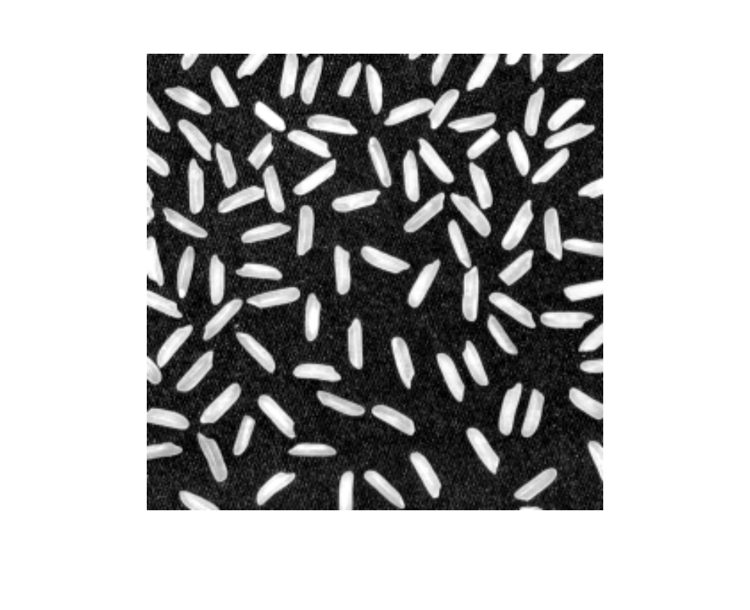
Increase the Image Contrast
I3 = imadjust(I2);
imshow(I3);

Slide 19
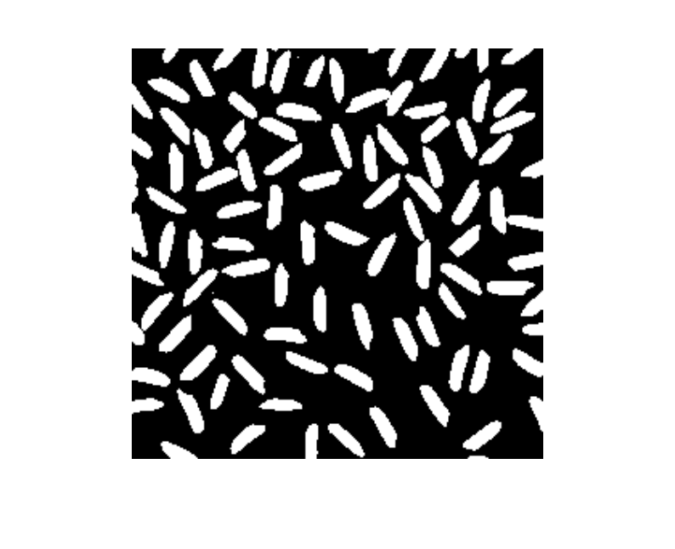
Threshold the Image
Create a new binary image by thresholding the adjusted image.
level = graythresh(I3);
bw = im2bw(I3,level);
imshow(bw)

Slide 20
Label Objects in the Image
The function BWLABEL labels all connected component in the binary image.
The accuracy of your results depend on:
  the size of the objects,
  the accuracy of your approximated background,
  whether you set the connectivity parameter to 4 or 8,
  whether or not any objects are touching (in which case they may be labeled as one object).
Some of the rice grains are touching.
  [labeled,numObjects] = bwlabel(bw,4); % 4-connected
  numObjects % Count all distinct objects in the image.
  numObjects =
  101

Slide 21
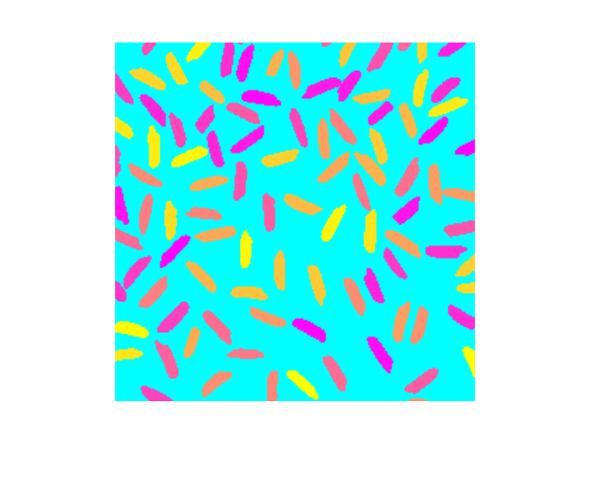
View the Whole Label Matrix
A good way to view a label matrix is to display it as a pseudo-color indexed image.
  In the pseudo-color image, the number that identifies each object in the label matrix maps to a different color in the associated colormap matrix.
  Use LABEL2RGB to choose the colormap, the background color, and how objects in the label matrix map to colors in the colormap.
RGB_label = label2rgb(labeled, @spring, 'c', 'shuffle');
imshow(RGB_label)

Slide 22
Measure Object Properties in the Image
The REGIONPROPS command measures object or region properties in an image and returns them in a structure array.
When applied to an image with labeled components, it creates one structure element for each component.
Use regionprops to create a structure array containing some basic properties for the labeled image.
graindata = regionprops(labeled,'basic')
graindata =
101x1 struct array with fields:
Area
Centroid
BoundingBox
% To find the area of the component labeled with 50s, use dot notation to
% access the Area field in the 50th element in the graindata structure array.
graindata(50).Area
ans = 203

Slide 23
Compute Statistical Properties of Objects in the Image
Create a new vector allgrains which holds the area measurement for each grain
allgrains = [graindata.Area];
max_area = max(allgrains) % Find the maximum area of all the grains.
max_area = 404
biggrain = find(allgrains==max_area) % Find the grain number that has this area.
biggrain = 59
mean(allgrains) % Find the mean of the area of all the grains.
ans = 175.0396

Slide 24
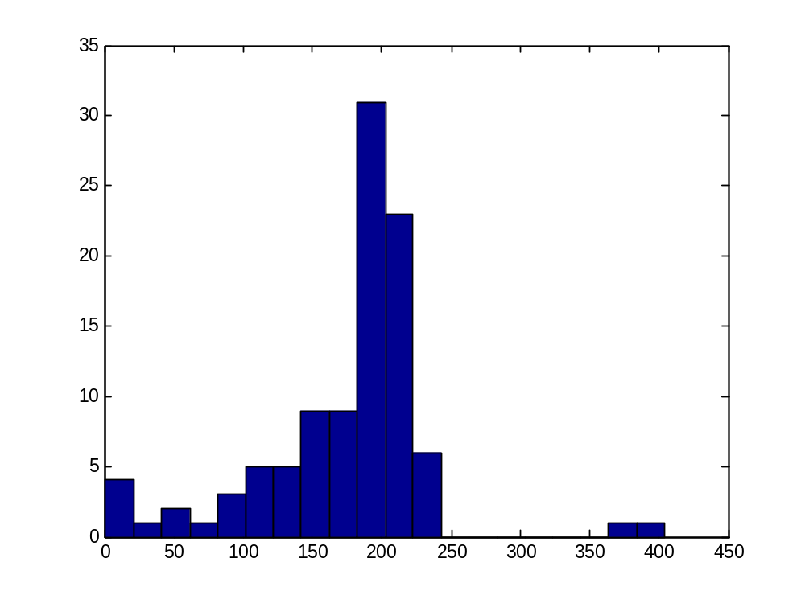
Create a Histogram of the Area of the Grains
nbins = 20;
figure,hist(allgrains,nbins)

Slide 25
**Presentation Assignment
Use Examples!
regionprops
label2rgb
strel
imdilate
imerode
imopen
imclose

Slide 26
**Presentation Assignment
Use Examples!
bwhitmiss: Logical AND of an image, eroded with one structuring element, and the image’s complement, eroded with a second structuring element.
Imbothat: Subtracts the original image from a morphologically closed version of the image. Can be used to find intensity troughs in an image.
Imtophat: Subtracts a morphologically opened image from the original image. Can be used to enhance contrast in an image.

Slide 27
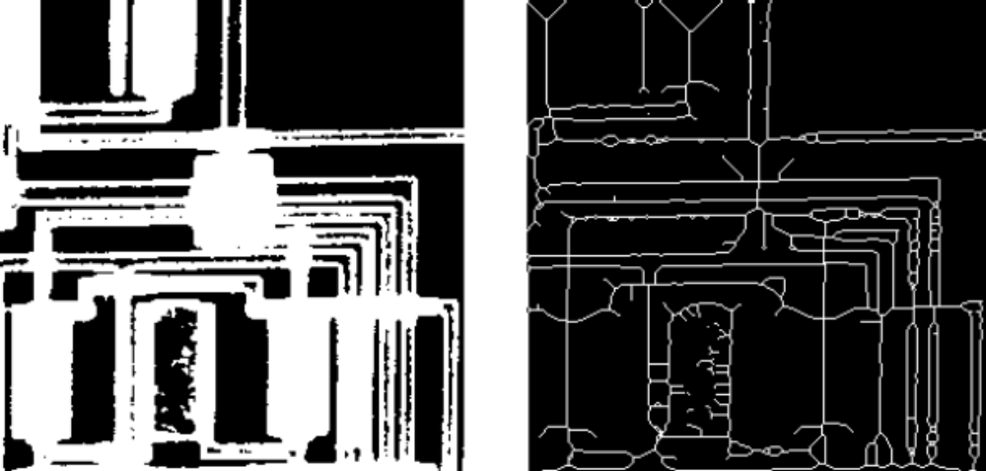
Skeletonization
To reduce all objects in an image to lines, without changing the essential structure of the image, use the bwmorph function.
BW1 = imread('circbw.tif');
BW2 = bwmorph(BW1,'skel',Inf);
imshow(BW1), figure, imshow(BW2)

